Slide 1

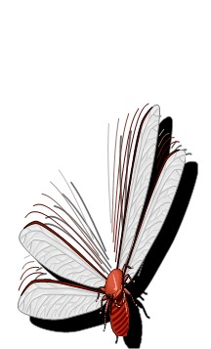
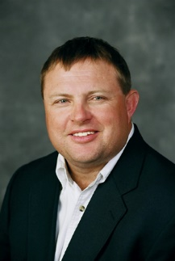

Trelona® ATBS
Annual Bait Stations
Keys to Success
System and Station Inspections
Click on slide or down arrow key
Dr. Bob Davis
Technical Services Representative
BASF Professional & Specialty Solutions
robert.davis@basf.com

Slide 2
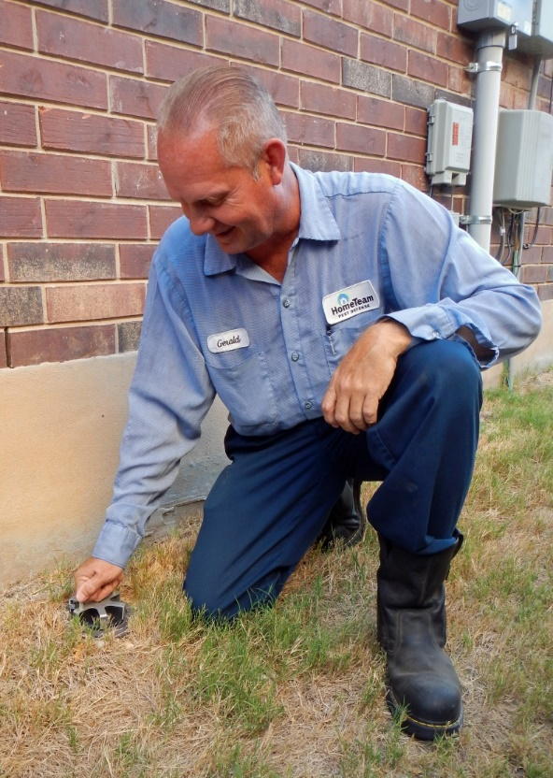
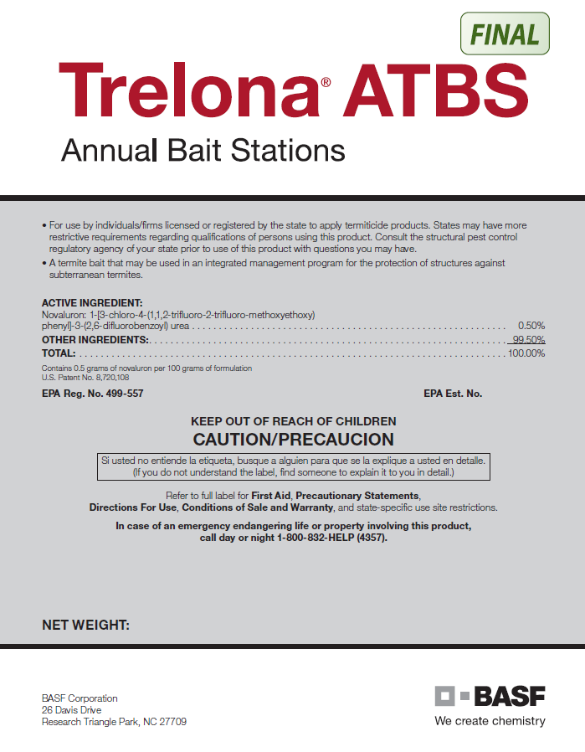
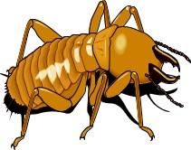
Inspecting & Servicing Trelona® ATBS Annual Bait Stations
Regularly scheduled inspections are critical for system, station and site maintenance
Follow label directions for scheduling
Remember to inspect structure as you inspect the stations!
Click on slide or down arrow key

Slide 3
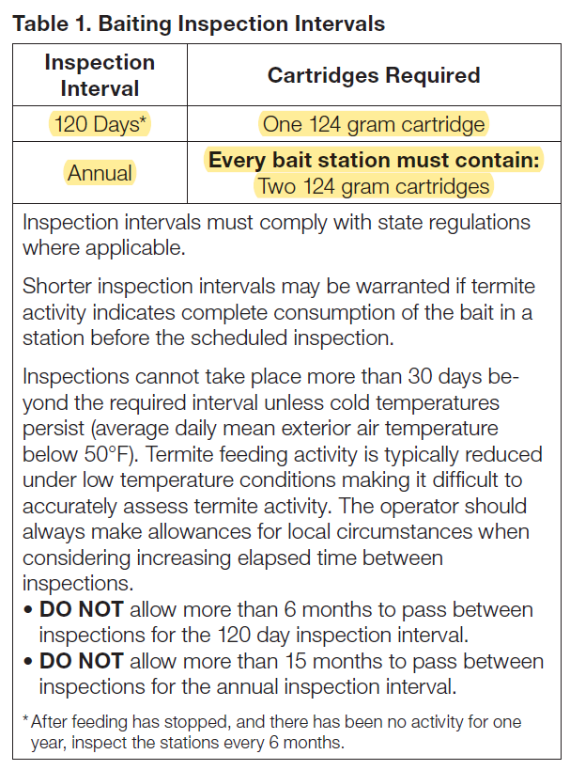
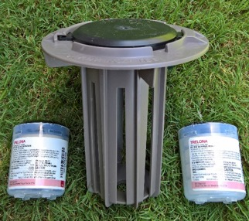
Trelona® ATBS Annual Bait Stations
Station Inspection Intervals per Label:
Table 1. Baiting Inspection Intervals
Use of two 124 gram cartridges in a station
  Annual inspection interval
  In order to have annual inspection interval, every bait station must contain two 124 gram cartridges
Click on slide or down arrow key

Slide 4
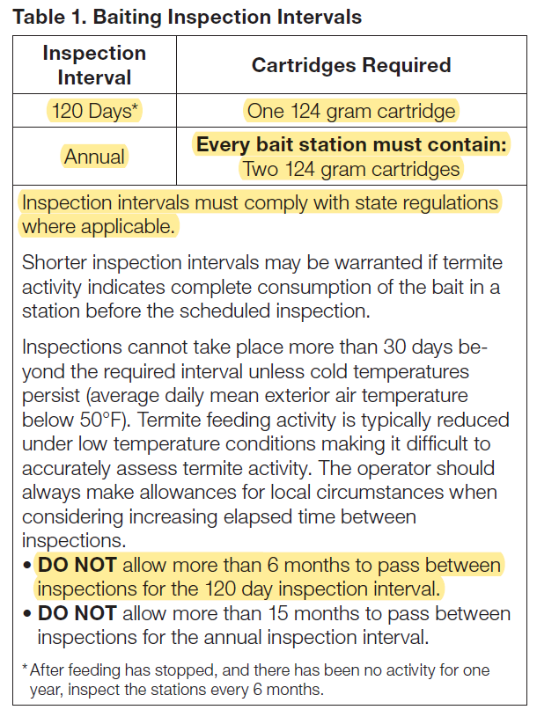
Trelona® ATBS Annual Bait Stations
Station Inspection Intervals per Label:
Table 1. Baiting Inspection Intervals
Use of one 124 gram Trelona bait cartridge in a station:
  Inspection interval is 120 days (3 times per year)
  After feeding has stopped and no activity for 1 year, inspect stations every 6 months
Inspection intervals must comply with state regulations where applicable
Click on slide or down arrow key

Slide 5
Trelona® ATBS Annual Bait Stations
Use Diagram of Structure to Locate and Service Stations
Stations numerically positioned and locations shown.
Amend diagram if new stations added, or stations are relocated over time.
Use landmarks for ease of station location.
  AC units, Windows, Hose bibs, Trees, Stumps, Weep holes, etc.
Click on slide or down arrow key

Slide 6
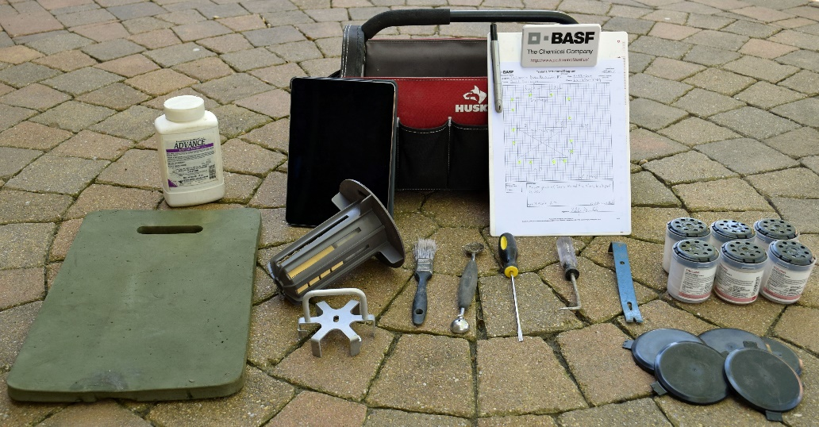
Trelona® ATBS
Recommended Inspection Tools
  Site diagram
  Tote
  Spider Tool
  Cotter pin/key puller
  Melon baller (or clean-out auger)
  Firm brush
  Nail claw (medium)
  Kneel pad or knee pads
  Trelona Bait Cartridges
  Probe or Screwdriver
  Permanent Marker
Click on slide or down arrow key
  Clean-out auger bit
  12. Extra lids
  Extra stations
  Ant bait

Slide 7
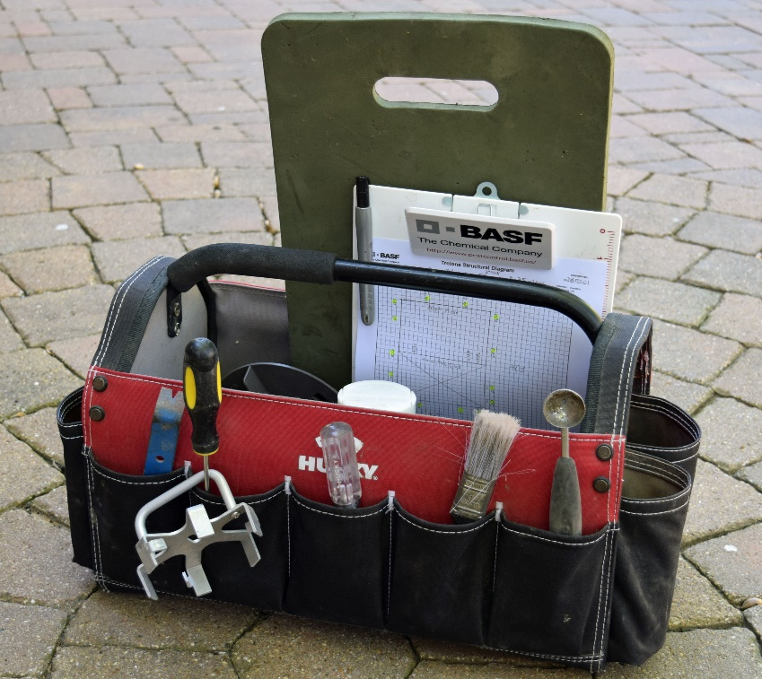
Inspecting & Servicing Trelona® ATBS Annual Bait Stations
Visit with occupants (if present)
Perform a site inspection
  Ensure access to property, no locked gates, etc.
  Ensure personal safety, no threatening dogs, etc.
  Check on diagram, see if changes to property since last inspection; additions, new landscaping, new pool or patio, etc.
Return to vehicle and gather tools for station inspections!
Click on slide or down arrow key

Slide 8
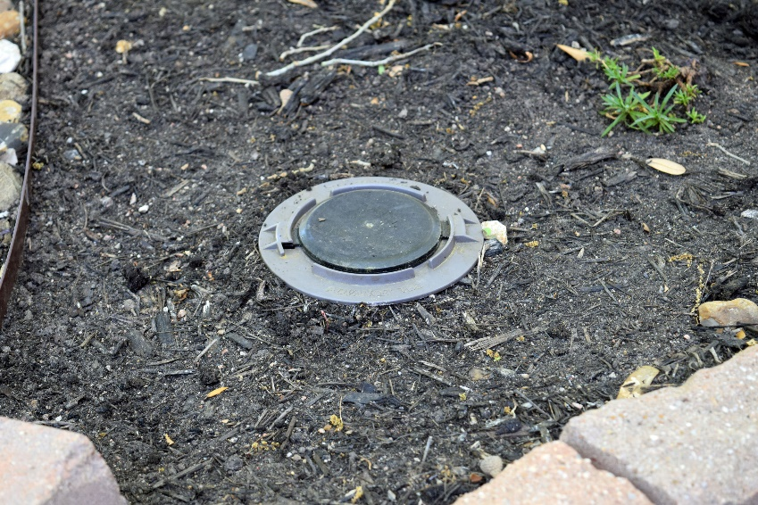
Inspecting & Servicing Trelona® ATBS Annual Bait Stations
Locate station
  Verify on the site diagram
Click on slide or down arrow key

Slide 9
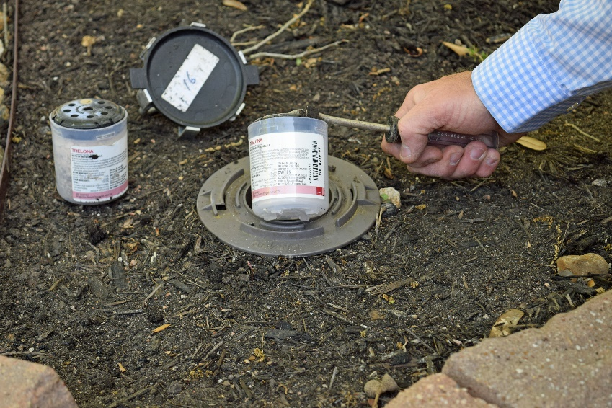
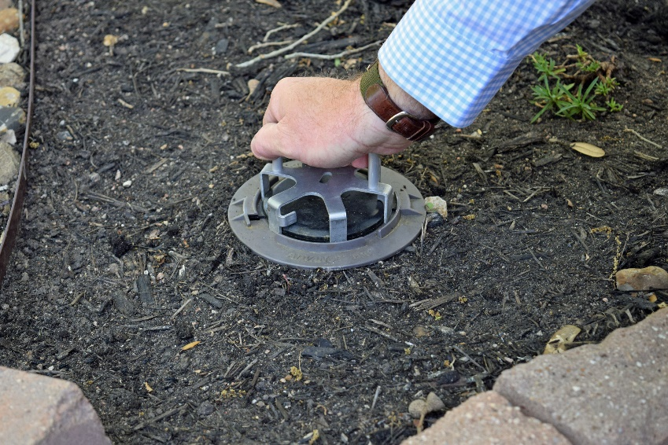
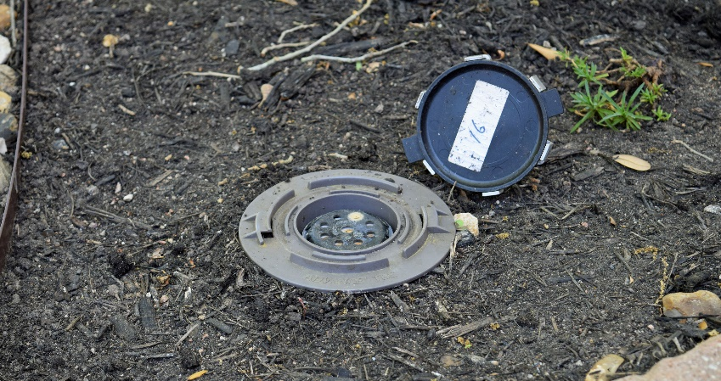
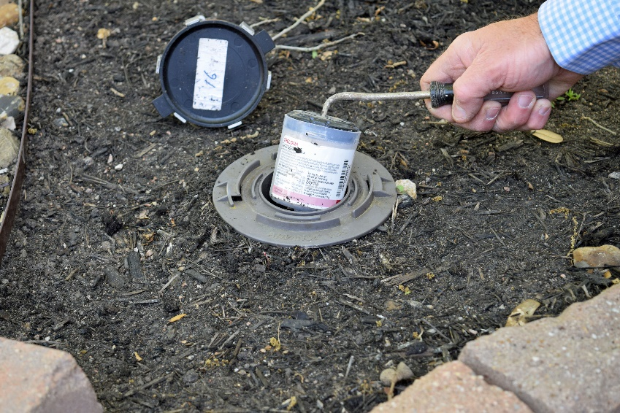
Inspecting & Servicing Trelona® ATBS Annual Bait Stations
Service station
  Station located
  Open station with spider tool
  Inspect top of TBC for termite activity and/or signs of feeding.
  Remove top TBC with cotter pin puller
  Remove bottom TBC with cotter pin puller
Click on slide or down arrow key

Slide 10
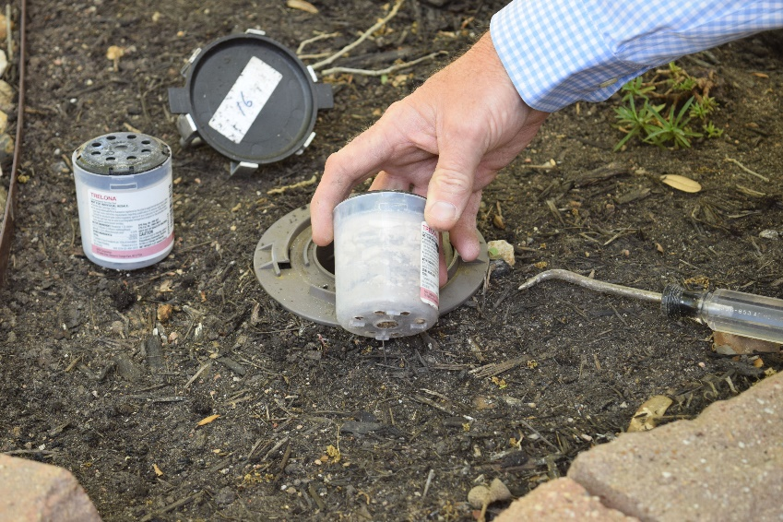
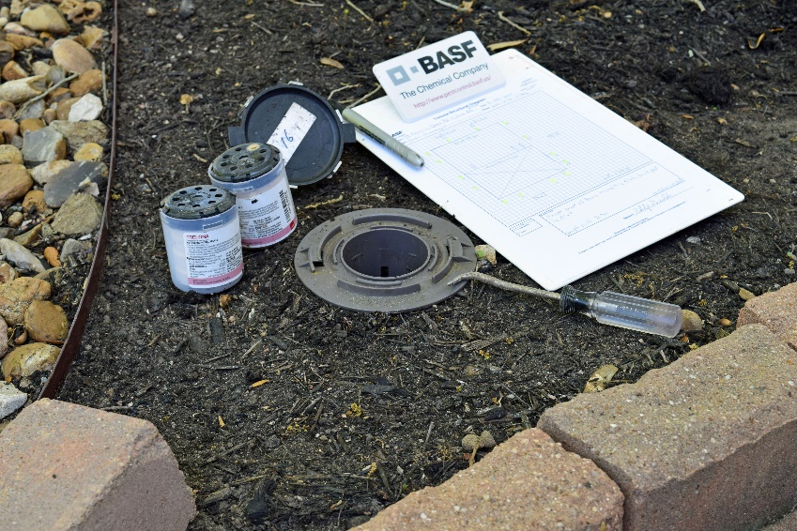
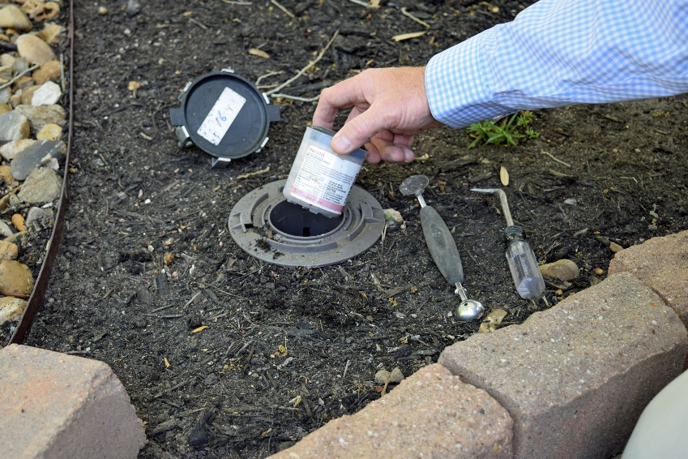
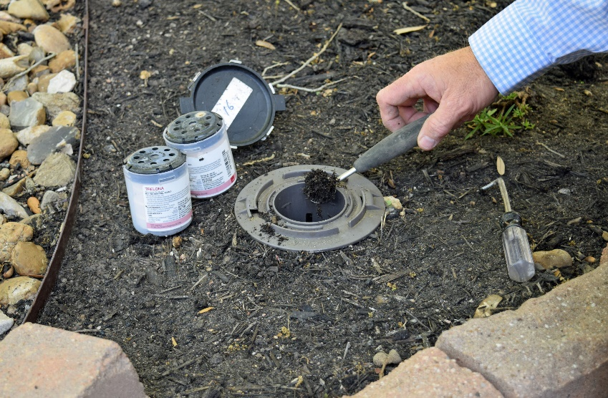
Inspecting & Servicing Trelona® ATBS Annual Bait Stations
Service station
  Inspect TBC’s for activity and/or feeding activity
    Replace cartridges with >1/3 of bait removed.
  Document your findings (hard copy or digital options)
  If needed, clean debris out of station to allow TBC’s to be inserted.
  Place TBC’s in station
Click on slide or down arrow key

Slide 11
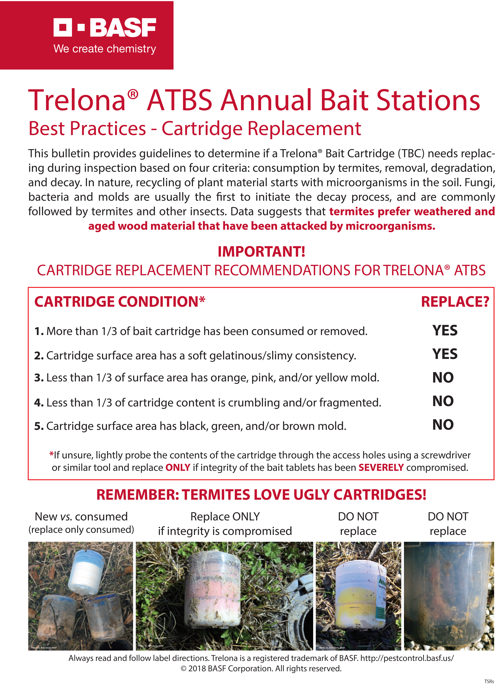
Inspecting & Servicing Trelona® ATBS Annual Bait Stations
When to replace the TBC’s?
  Best Practices – Cartridge Replacement
  Replace when:
    >1/3 of the bait within a cartridge has been consumed or removed.
    Bait tablets have a soft gelatinous/ slimy consistency.
    Tablets are falling apart due to decomposition (granular appearance).
Click on slide or down arrow key

Slide 12
Inspecting & Servicing Trelona® ATBS Annual Bait Stations
When not to replace the TBC’s?
  Best Practices – Cartridge Replacement
  Do not replace:
    When <1/3 of the bait within a cartridge has been consumed or removed.
    Mold, mildew, fungus, etc., are on or covering the tablets.
    Slugs, snails, worms, ants, snakes, etc., are associated with the cartridges.
    Pest control products or fertilizers are applied over top of station.
Click on slide or down arrow key

Slide 13
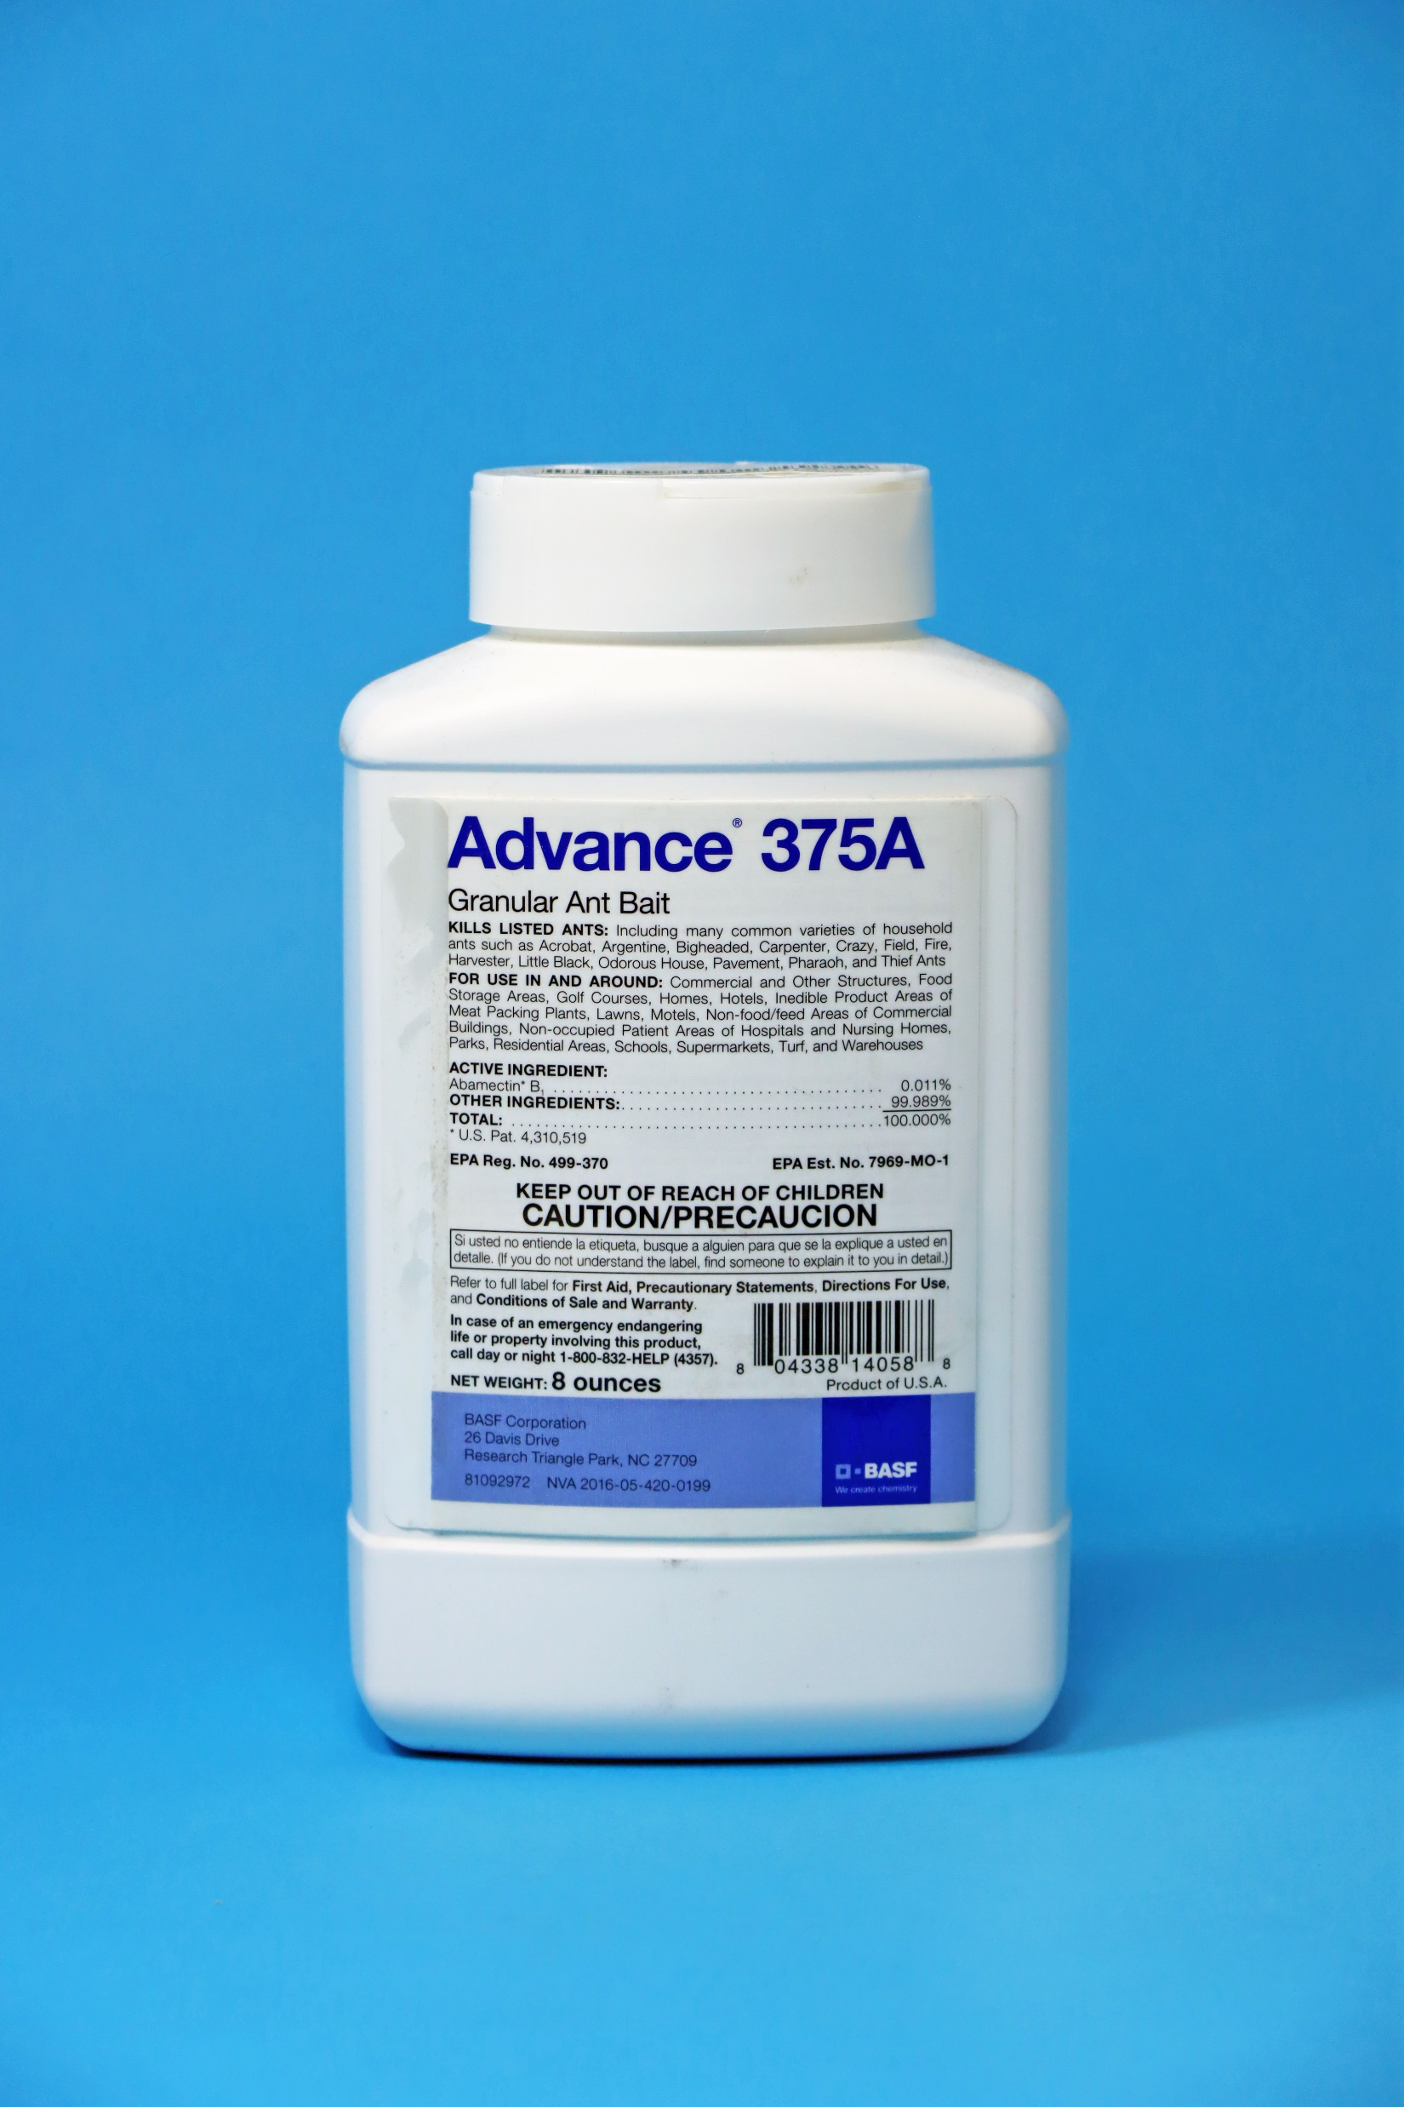
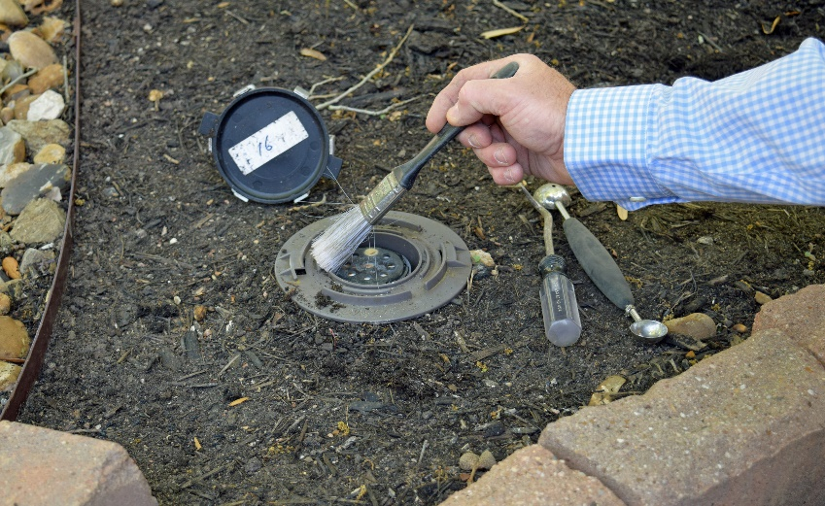
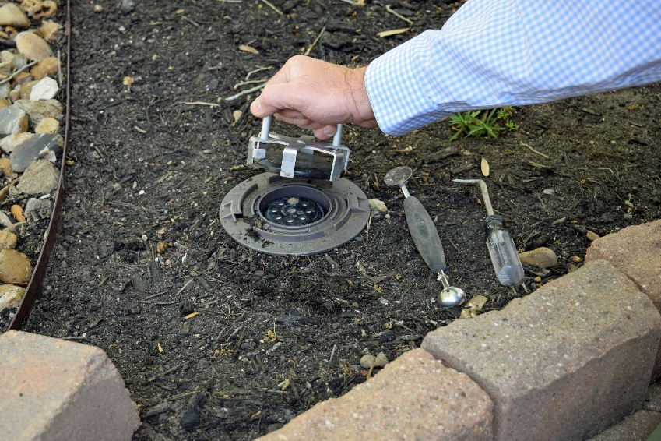
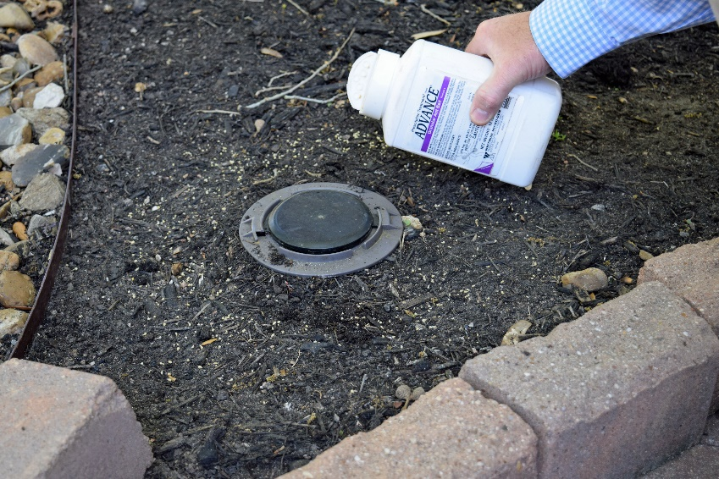
Inspecting & Servicing Trelona® ATBS Annual Bait Stations
Service station
  If needed, use brush to remove debris from station top to allow lid to close securely.
  Replace lid on station top with Spider tool.
  If needed, treat around station with granular ant bait.
  All done! Move on to next station and continue until all stations inspected.
  Make concerted effort to inspect structure!
Click on slide or down arrow key

Slide 14

Inspecting & Servicing Trelona® ATBS Annual Bait Stations
Return all inspection tools and items to the service vehicle.
Install new or relocate Trelona ATBS Annual Bait Stations as needed
Complete remainder of site inspection services.
Perform a closing walk around to verify all items retrieved, etc.
Complete all paperwork, etc.
Close service with occupants (if present)
On to the next service!
Click on slide or down arrow key

Slide 15

Thank You!
Trelona ATBS Annual Bait Stations
Visit TrelonaATBS.com
https://www.pestcontrol.basf.us/
Label & SDS Resources available at CDMS.net
Label Training Program available at https://training.pctonline.com/#/landing
Trelona ATBS Stations and Materials Available at your trusted BASF Distributor!
Click on slide or down arrow key
Dr. Bob Davis
Technical Services Representative
BASF Professional & Specialty Solutions
robert.davis@basf.com

Slide 16
BASF Product Stewardship
Product Stewardship is everybody’s responsibility
  Always Read and Follow Label Directions.
  Always Refer to Label for Registered Uses.
  Uses not included on the Label have not been evaluated for human and environmental safety.
  Use of products for non-labeled uses is a violation of federal law and can result in human and environmental hazard.
Click on slide or down arrow key

Slide 17


